Slide 1
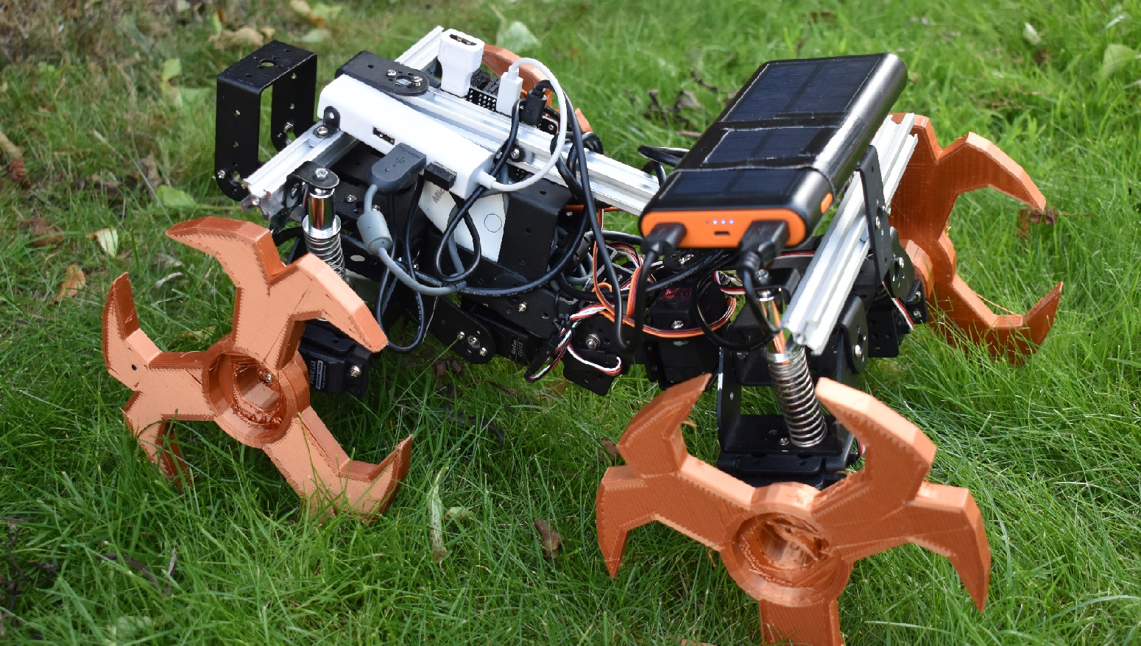
Bio-Inspired Navigation on Varied Terrain
Dexter Shepherd

Slide 2
Aims of the project

Slide 3
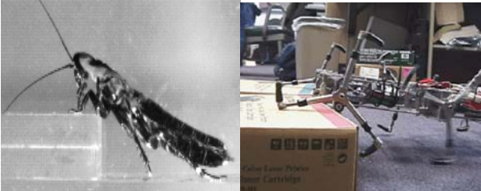
Inspiration
Cockroach locomotion
Project PROLERO

Slide 4
Simulation

Slide 5
Computer vision

Slide 6
Physical robot implementation

